Slide 1
Hotel Recommendation System
Submitted by
Nilakrishna M

Slide 2
objective
To build hotel recommender system which will help the user to book the best hotel out of all the other hotels using customer reviews and ratings.
The dataset that is downloaded from Kaggle. The data was scraped from Booking.com. This dataset contains 515,000 customer reviews and scoring of 1493 luxury hotels across Europe.
Booking.com is a Dutch online travel agency for lodging reservations & other travel products, and a subsidiary of Booking Holdings. It is headquartered in Amsterdam. Booking.com supported internationally by 198 offices in over 70 countries around the world. The website has over 28 million listings. The site is available in 43 languages.

Slide 3
Features
The csv file contains 17 fields. The description of each field is as below:
Hotel_Address: Address of hotel.
Review_Date: Date when reviewer posted the corresponding review.
Average_Score: Average Score of the hotel, calculated based on the latest comment in the last year.
Hotel_Name: Name of Hotel
Reviewer_Nationality: Nationality of Reviewer
Negative_Review: Negative Review the reviewer gave to the hotel. If the reviewer does not give the negative review, then it should be: 'No Negative'
ReviewTotalNegativeWordCounts: Total number of words in the negative review.
Positive_Review: Positive Review the reviewer gave to the hotel. If the reviewer does not give the negative review, then it should be: 'No Positive'
ReviewTotalPositiveWordCounts: Total number of words in the positive review.
Reviewer_Score: Score the reviewer has given to the hotel, based on his/her experience
TotalNumberofReviewsReviewerHasGiven: Number of Reviews the reviewers has given in the past.
TotalNumberof_Reviews: Total number of valid reviews the hotel has.
Tags: Tags reviewer gave the hotel.
dayssincereview: Duration between the review date and scrape date.
AdditionalNumberof_Scoring: There are also some guests who just made a scoring on the service rather than a review. This number indicates how many valid scores without review in there.
lat: Latitude of the hotel
lng: longtitude of the hotel

Slide 4
Implementation
1. Loading the hotel review dataset
2. Preprocessing
Extracting countries from Hotel address to identify the country. Netherlands,UK,France ,Spain, ,Italy, Austria are the countries in this dataset
Drop the unnecessary columns that we don’t need for the task of creating a hotel recommendation system
Create a function to convert the strings of list into a normal list and then apply it to the “Tags” column in the dataset.
3. Define a function to recommend the names of hotels according to the location and the description provided by the user. Here our aim is not just to recommend the name of the hotel but also rank it according to the user ratings.
Tokenization, Stop words removal, Lemmatization is done on Tags feature and the description we input.
Vectorize the set
Cosine similarity metric used to measure how similar the vectors are.
Recommend the hotels based on the similarity

Slide 5
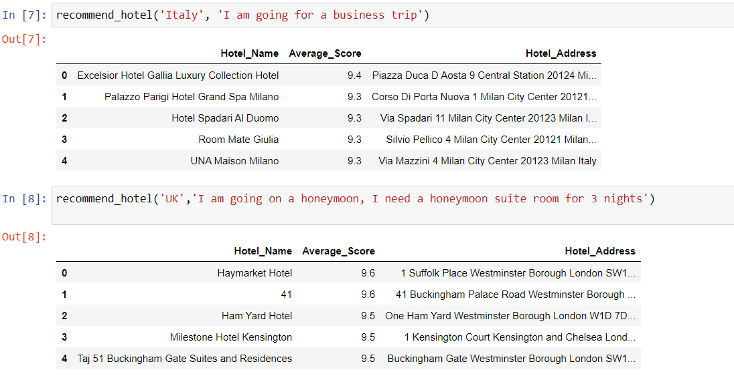
4. Test function by selection any country out of the 6 countries mentioned in the dataset and describing the purpose of our trip.

Slide 6
THANK YOU

